Slide 2
MDW Scenarios, Use Cases and Patterns
Kal Yella and Tammy Richter Jones

Slide 3
Data Warehouse
Ingest
Store
Model & Serve
Intelligence
Logs, files and media (unstructured)
Azure storage/ ADLS Gen2
Data factory
Business / custom apps
(Structured)
Data factory
Azure SQL Data Warehouse
Analytical dashboards

Slide 4


Modern Data Warehouse
INGEST
STORE
PREP & TRAIN
MODEL & SERVE
Logs (unstructured)
Azure Databricks
Media (unstructured)
PolyBase
Files (unstructured)
Azure Data Factory
Azure Blob Storage
Azure SQL Data Warehouse
Azure Analysis Services
Power BI
Business/custom apps
(structured)
Microsoft Azure also supports other Big Data services like Azure HDInsight and Azure Data Lake to allow customers to tailor the above architecture to meet their unique needs.

Slide 5
Base Patterns

Slide 6
Suitable workloads
Analytics
Store large volumes of data.
Consolidate disparate data into a single location.
Shape, model, transform and aggregate data.
Perform query analysis across large datasets.
Ad-hoc reporting across large data volumes.
All using simple SQL constructs.
“SQL on SQL”

Slide 7
Unsuitable workloads
Operational workloads (OLTP)
High frequency reads and writes.
Large numbers of singleton selects.
High volumes of single row inserts.
SQL
Data Preparation
Row by row processing needs.
Incompatible formats (JSON, XML).
SQL

Slide 8






Resume / Pause Pattern
Persist
Export
Query
Stream
Import
Import
Resume
Ingest
Aggregate
Export
Pause
Lower Cost
High Concurrency
“Dashboard Query”
Notes:
Red Stars
Archive on the way in to the warehouse
Geo-redundant blob storage guarantees your data
Allows for RPO 0 Data Warehouse architectures
Allows for point in time restart-ability of ELT
Resume / Pause Pattern

Slide 9

SaaS customer isolation
DWU 200
DWU 600
Customer
Clickstream
Corporate
DWU 1200
Notes:
Red Stars
Consistent single view of raw data held in Blob Storage accessible by all consumers of data
Customer specific DWU settings allowing for simple chargeback models

Slide 10


Big Data & SQLDW
Unknown Value Data
XML
High Value Data
JSON
TEXT
Model
Load
Transform
Aggregate
Consume
Data Preparation
Pre-process
Transpose
Re-format
Batch
Ad-hoc
Batch
Parquet

Slide 11
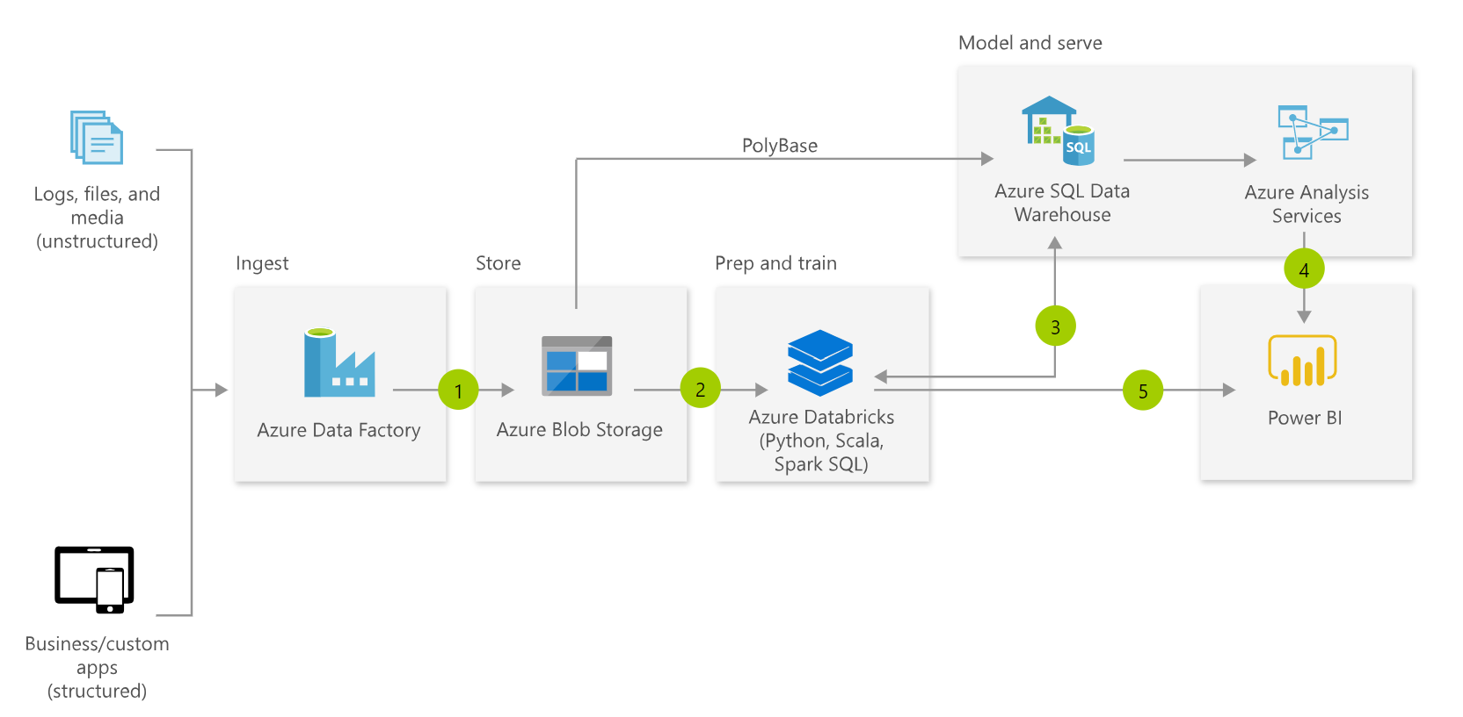
Typical MDW Architecture
Notes:
Fully managed

Slide 12
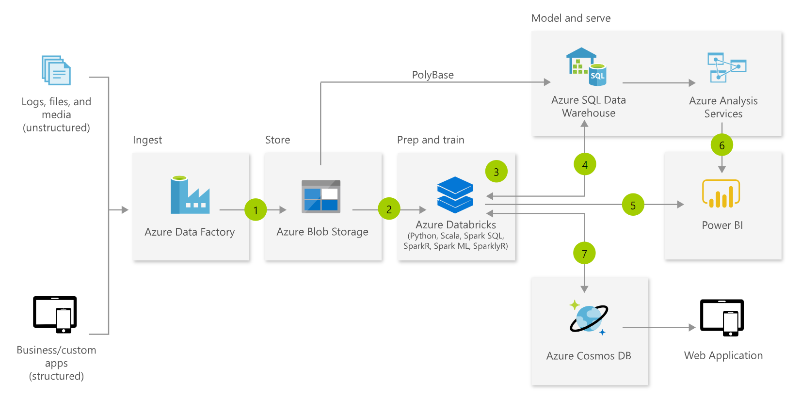
Advanced Analytics

Slide 13
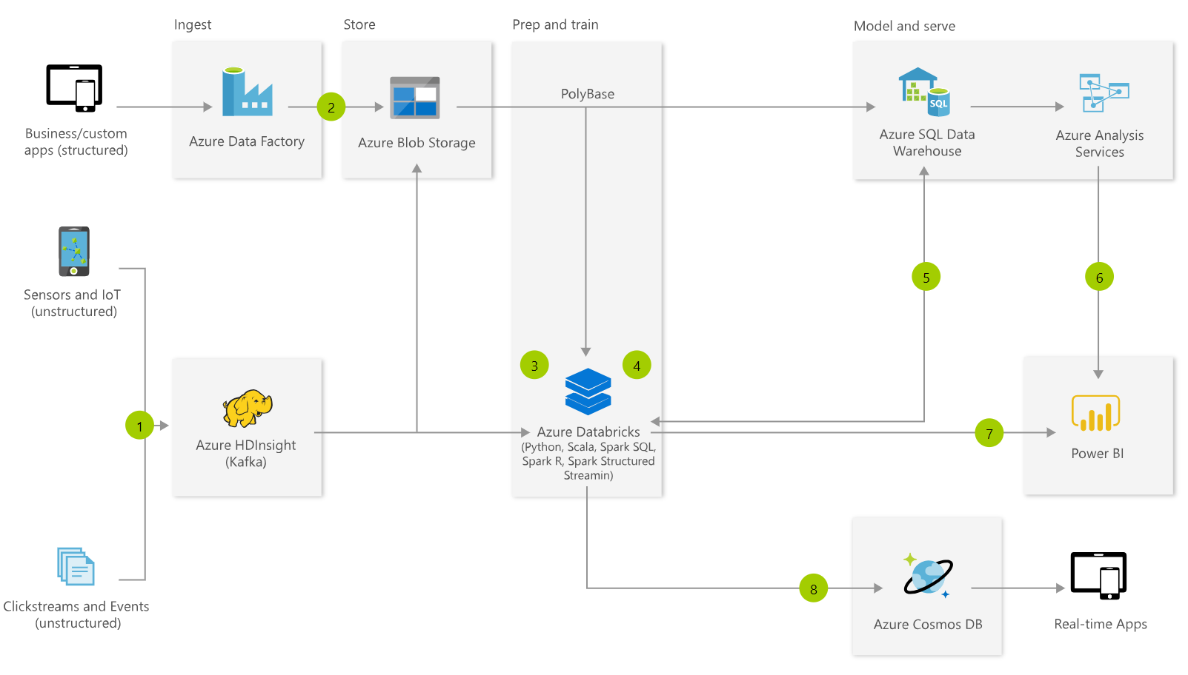
Real-time Analytics

Slide 14
hub & Spoke architecture for bi
INGEST
STORE
PREP & TRAIN
MODEL & SERVE
Data Marts
Business/custom apps
(structured)
SQL
Azure Databricks
Multiple Azure SQL Database instances
Logs (unstructured)
PolyBase
Azure Data Factory
Azure Blob Storage
Azure SQL Data Warehouse
Power BI
Media (unstructured)
Data Cubes
Multiple Azure Analysis Services instances
Files (unstructured)
Microsoft Azure supports other services like Azure HDInsight and Azure Data Lake in various layers to allow customers a truly customized solution.

Slide 15
Auto scaling Data Warehouse
INGEST
STORE
PREP & TRAIN
MODEL & SERVE
Business/custom apps
(structured)
Azure Databricks
Logs (unstructured)
PolyBase
Azure Data Factory
Azure Blob Storage
Azure SQL Data Warehouse
Azure Analysis Services
Power BI
Media (unstructured)
Azure Functions
(Auto-scaling)
Files (unstructured)
Microsoft Azure supports other services like Azure HDInsight and Azure Data Lake in various layers to allow customers a truly customized solution.

Slide 16



Data Warehouse migration
INGEST
STORE
PREP & TRAIN
MODEL & SERVE
Business/custom apps
(structured)
PolyBase
Azure SQL Data Warehouse
Business/custom apps
Logs (unstructured)
Azure Analysis Services
Media (unstructured)
Azure Data Factory
Azure Blob Storage
Azure Databricks
Power BI
Files (unstructured)
Azure also supports other Big Data services like Azure HDInsight and Azure Data Lake to allow customers to tailor the architecture to meet their unique needs.

Slide 17
Custom Patterns

Slide 18
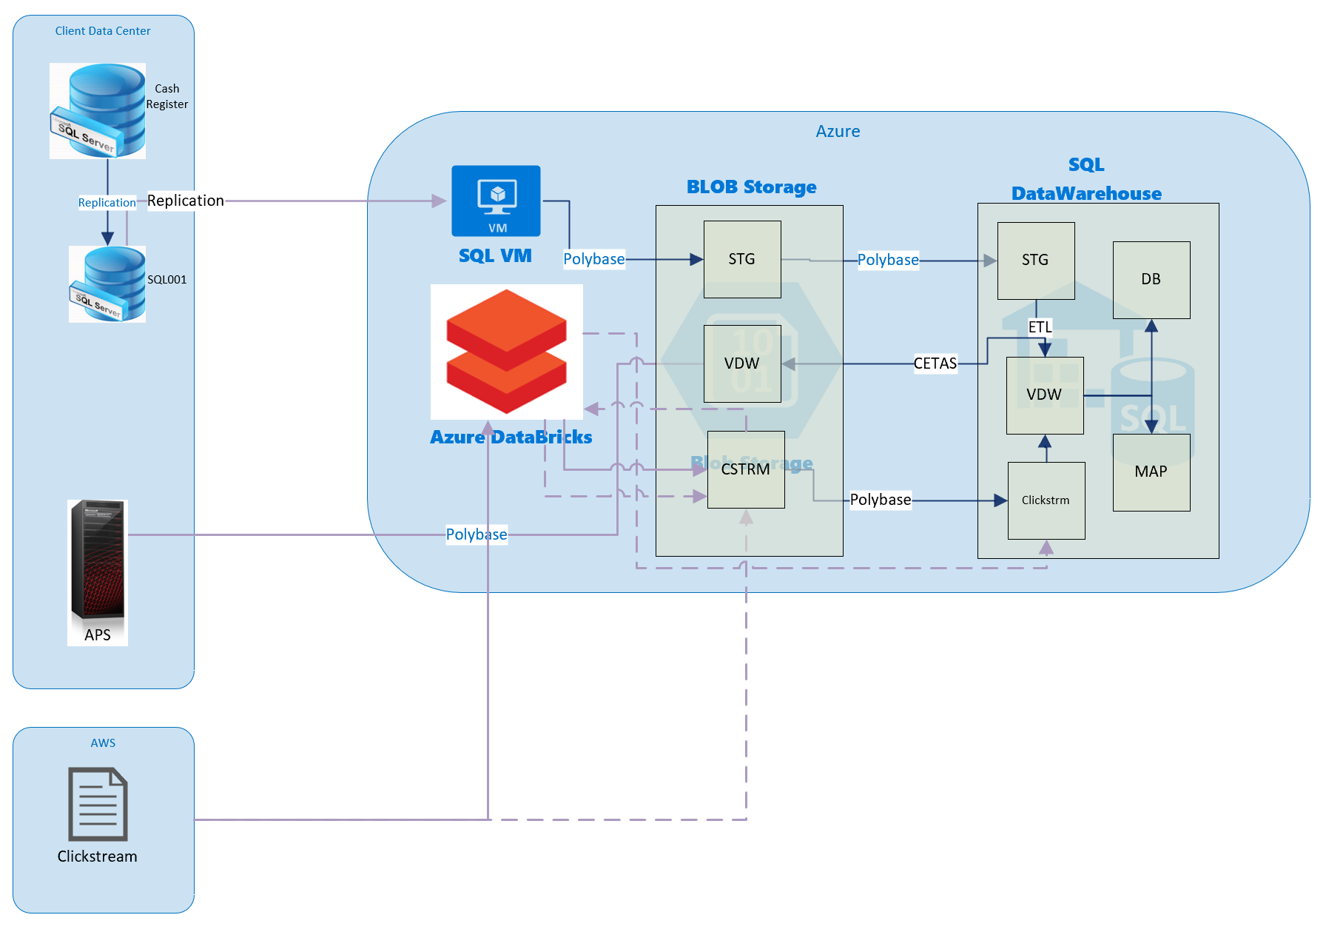
Data Warehouse Reverse migration

Slide 19
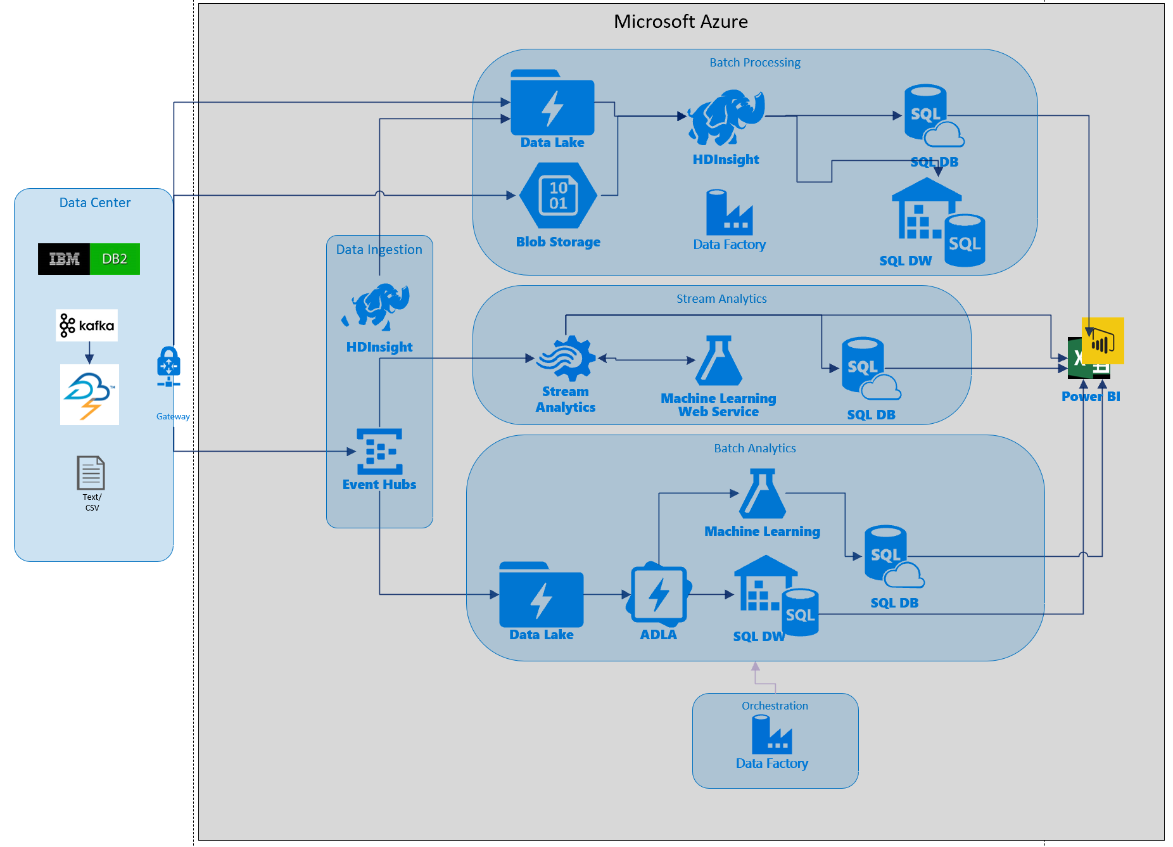

Slide 20
Loading Patterns

Slide 21
Loading patterns
Pattern 1: Batch loads (PolyBase)
Load large volumes of data are in parallel
Move data from Azure storage to SQL DW in parallel to Compute nodes.
Pattern 2: Streaming loads (BCP)
Single record or micro batches in each load.
Data moves from source to the Control node and then to the Compute nodes.
Pattern 3: Structured Streaming (ADB)
Real-time data writes using SQL DW connector
Uses Polybase and structured streaming API
From Kafka, Kinesis sources at a user-configurable rate

Slide 22
Polybase parallel load from Azure Storage
Compute Node
Azure Storage Blob (ASB)
DMS
Bridge
Control Node
Compute Node
DMS
DMS
Bridge
Compute Node
DMS
Bridge

Slide 23
Single gated client
Compute Node
DMS
Bridge
Control Node
Compute Node
Client
DMS
DMS
Bridge
Compute Node
DMS
Bridge

Slide 24
Single gated client parallelized
Compute Node
DMS
Bridge
Client
Control Node
Compute Node
Client
DMS
DMS
Bridge
Client
Compute Node
DMS
Bridge

Slide 25
Consumption Patterns

Slide 26
Consumption patterns
Pattern 1: Direct Access
PBI Direct Query
Client Tools (SSMA, Data Tools etc.)
Third-party reporting tools (Talend, Qlik etc.)
Pattern 2: Semantic Layer
Tabular models using AAS
OLAP models through SSAS
Data Marts (SQL DB, SQL VM etc.)
Pattern 3: Translation Layer
Datometry Hyper-Q for custom apps

Slide 27







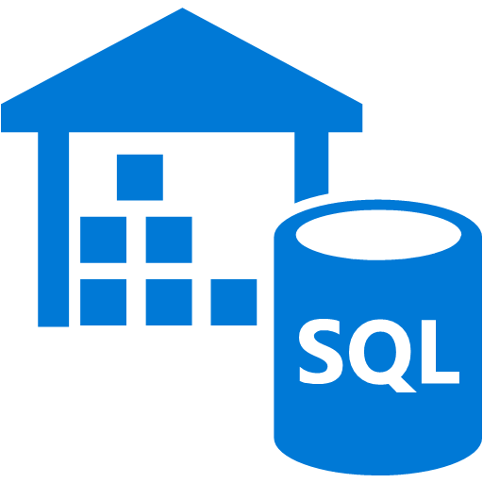



3rd Party Appliance to SQLDW Migration Scenario
Extract data from each table into multiple CSVs using appropriate export tool (Ex: Fastexport for Teradata).
Compress the files and upload to Azure Storage.
Use Polybase to load the data into SQLDW
Azure
Upload
Azure Blob Storage
Server X or empty slot
Staging DB
Server Y
Local Storage
One-Off Load into Staging / Data Warehouse / Data Mart schemas
Polybase
Analytics
Server Z
3a
Reporting
Back Up Server
Data Warehouse
Export
VM
3b
STAGING
DATA WAREHOUSE
DATA MART
STORED PROCEDURES
And VIEWS
Data Mart
Schema Conversion
Teradata/Netezza/Exadata
Azure SQL Data Warehouse
(One Single DB with Unique Staging / Data Warehouse / Data Mart Schemas)
Express Route
Express Route

